Slide 1


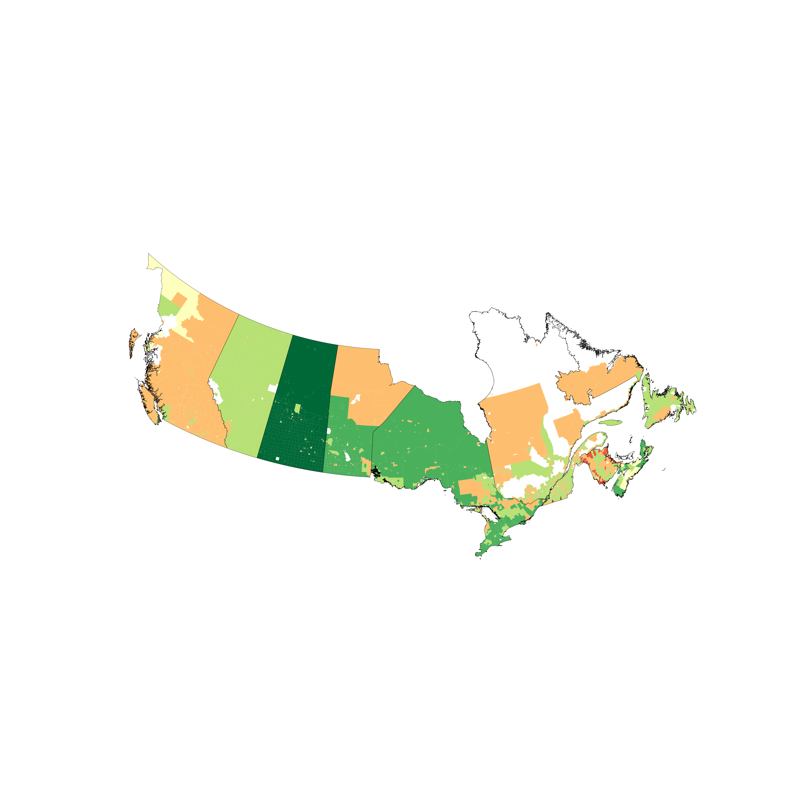
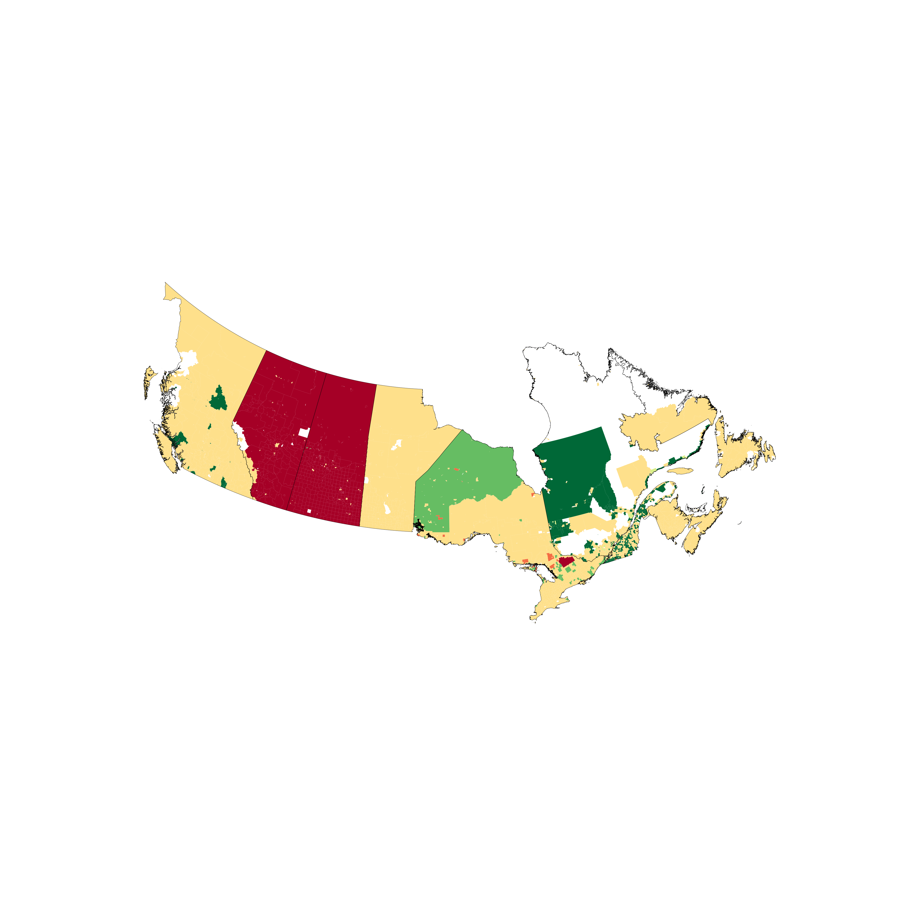
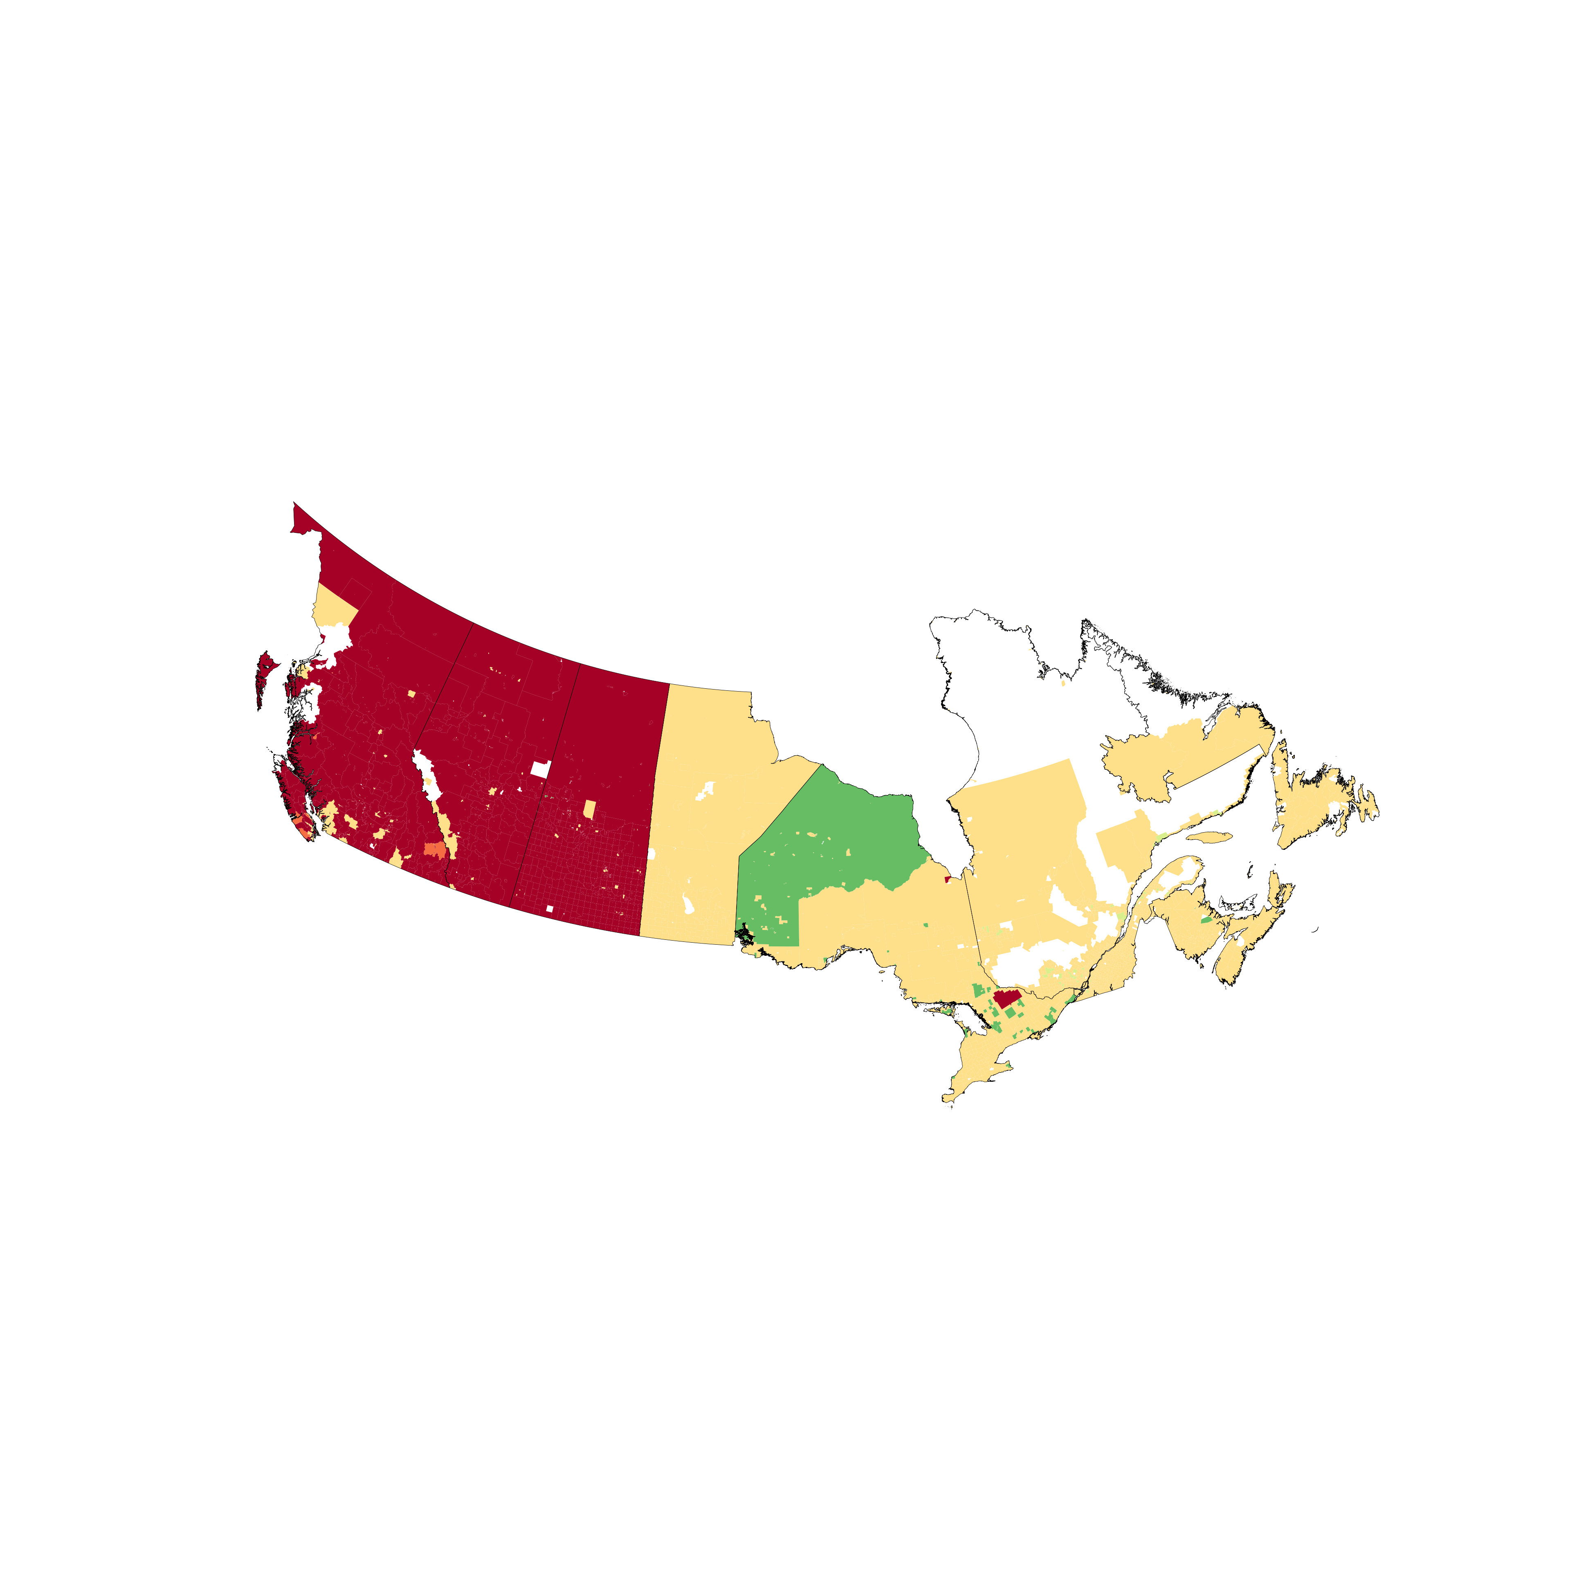
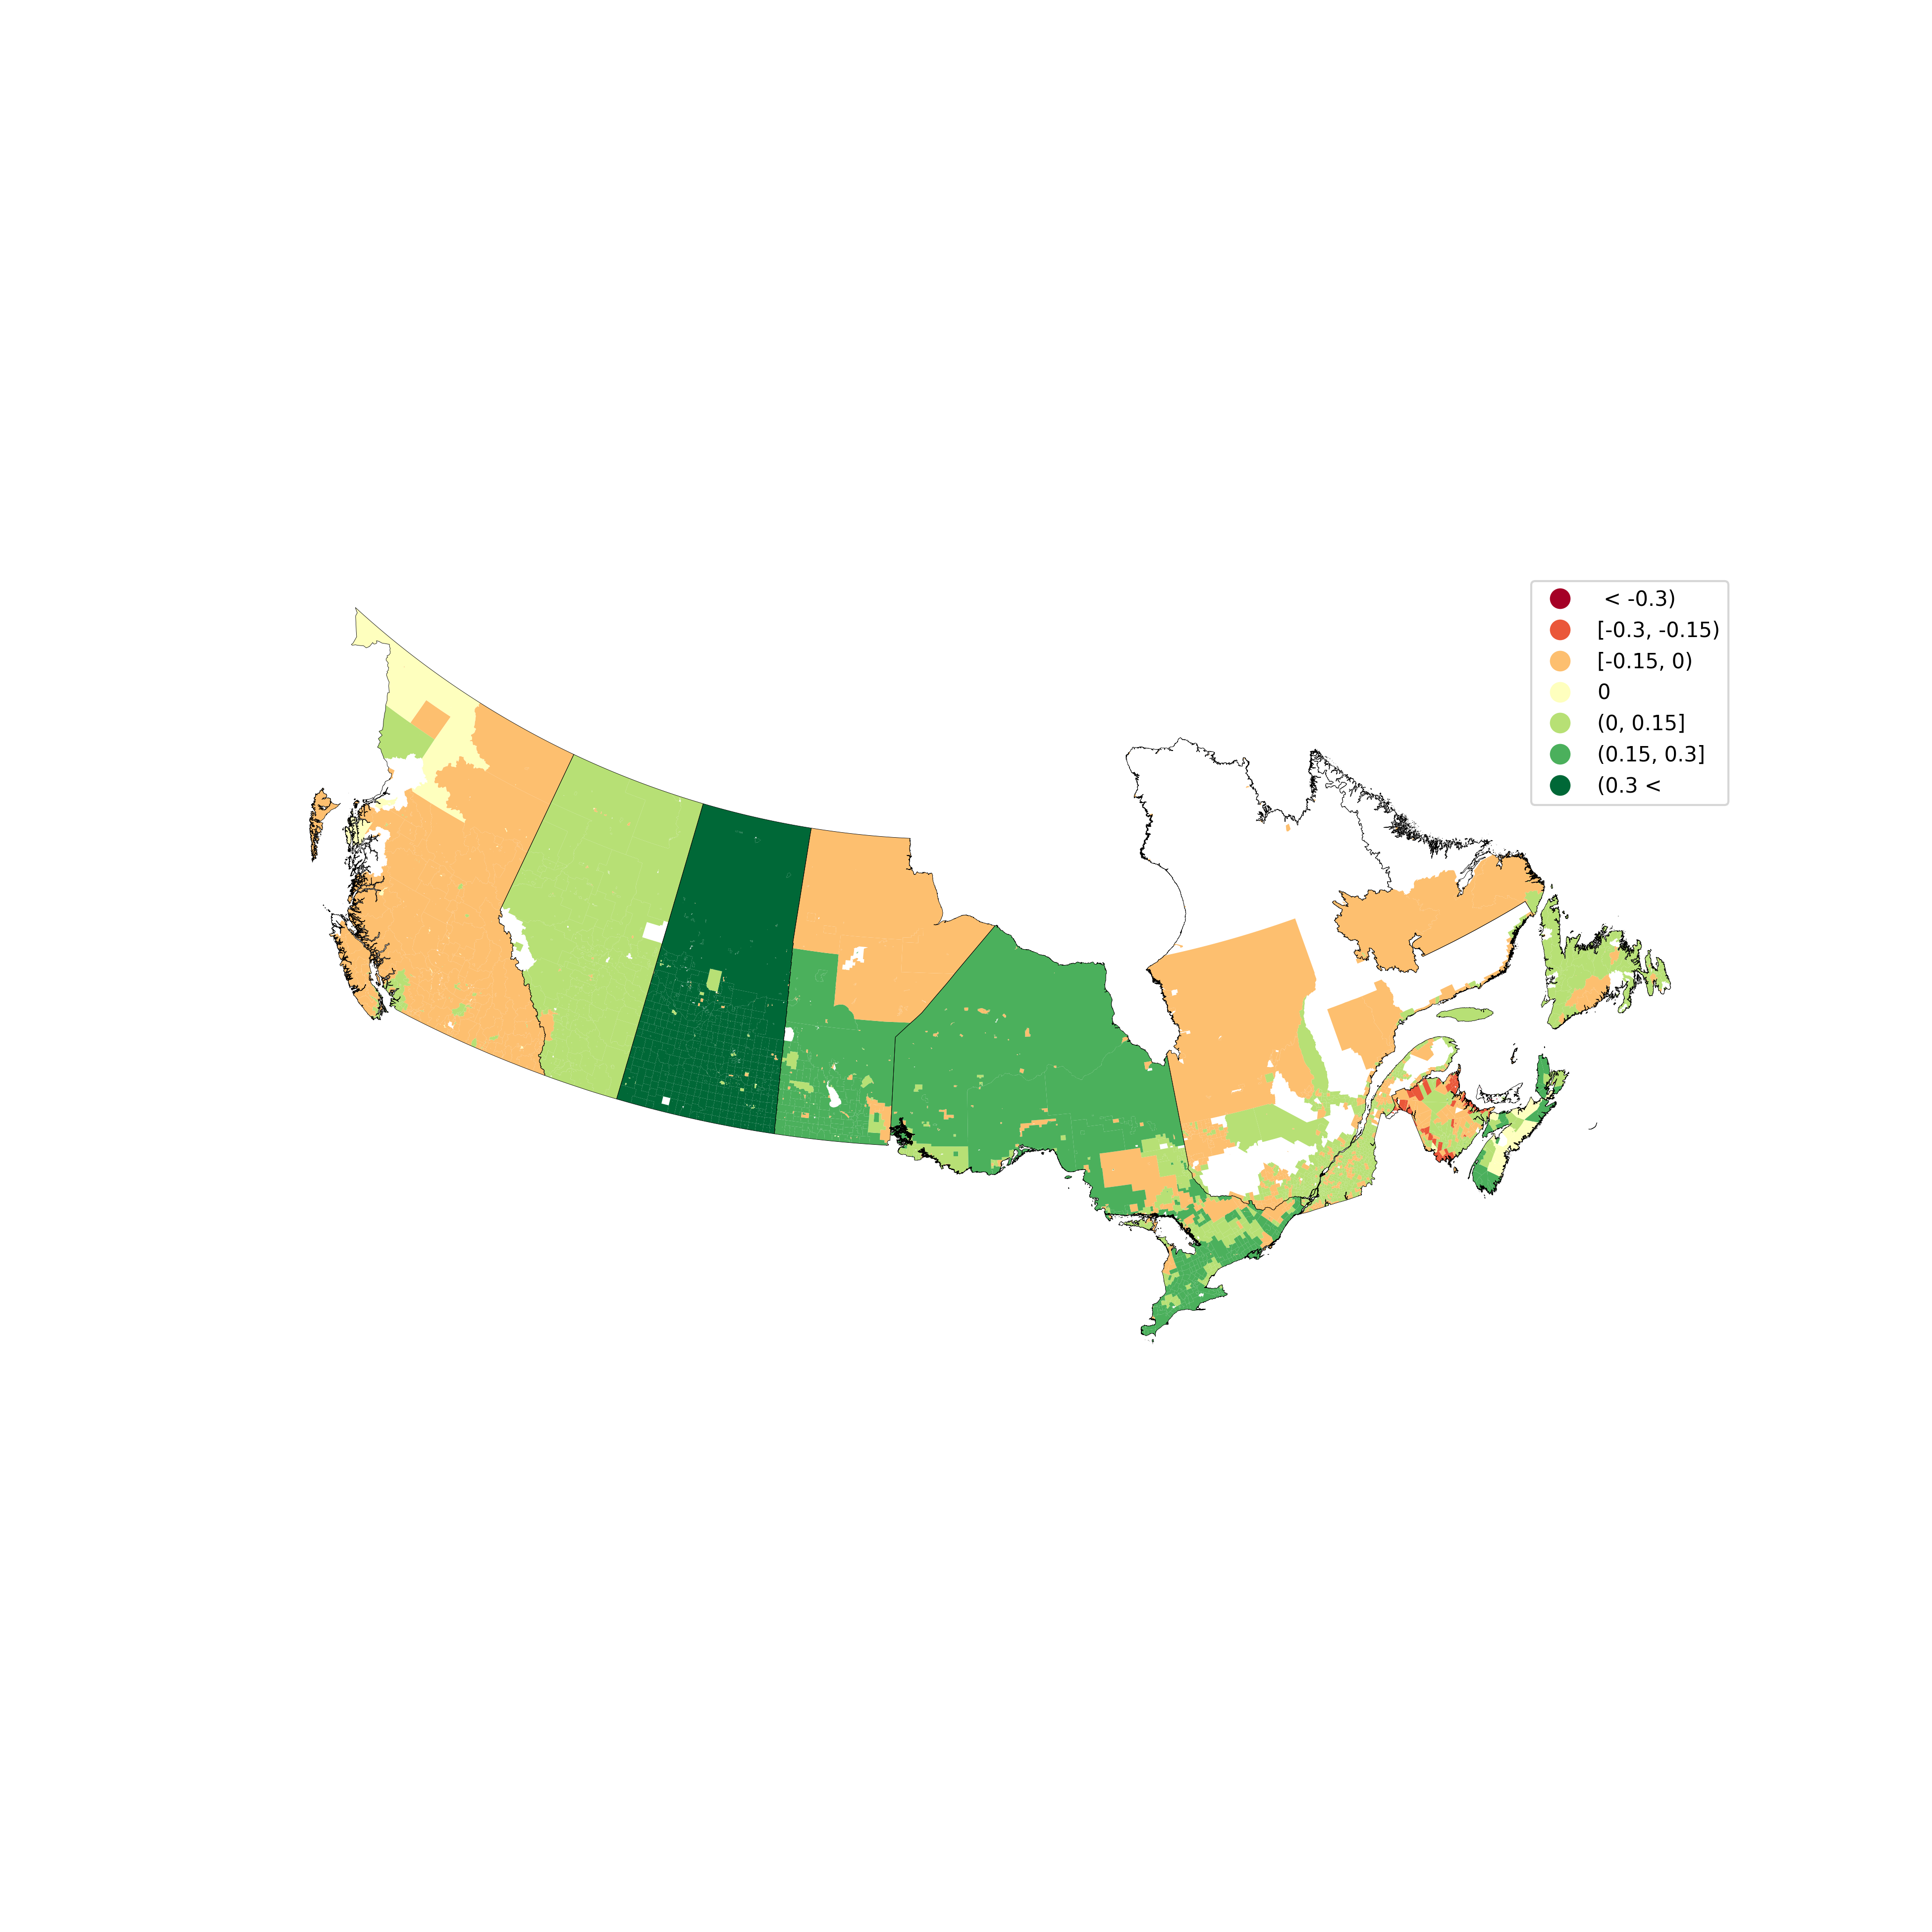





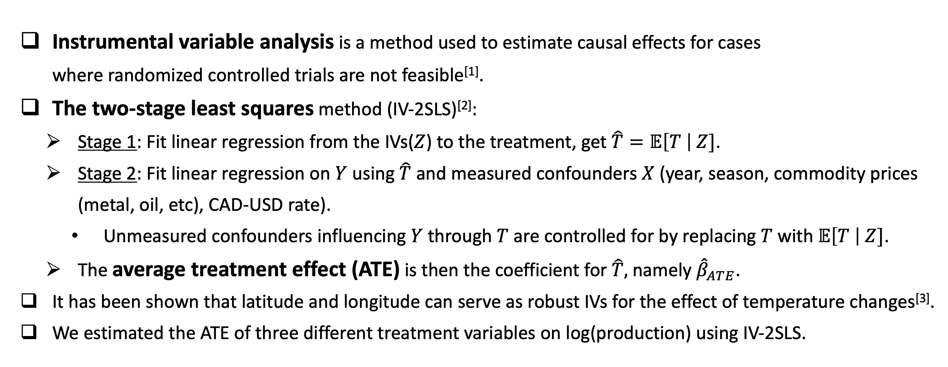
The causal impacts of climate change on Canadian industrial production: An instrumental variable analysis using geographical features as instruments
Sonny Min, Donghui Son, Lloyd T. Elliott
Department of Statistics and Actuarial Science, Simon Fraser University
Code
Motivation
Two-stage least squares (IV-2SLS) method
In order to adequately prepare for climate change, it is imperative to comprehend the impact of climate change on industries in Canada.
However, the conventional regression method fails to provide a precise influence of temperature changes on these industries due to biases induced by the presence of unmeasured confounders.
Furthermore, conducting a randomized controlled trial (RCT) to ascertain these effects is unfeasible.
In this project, we use instrumental variable analysis to determine the causal impacts of three temperature factors on economic productivity in Canadian census subdivisions.
Instrumental variable analysis is a method used to estimate causal effects for cases where randomized controlled trials are not feasible^{[1]}.
The two-stage least squares method (IV-2SLS)^{[2]}:
Stage 1: Fit linear regression from the IVs($Z$) to the treatment, get $\hat{T}=𝔼\left[T \right| Z]$.
Stage 2: Fit linear regression on $Y$ using $\hat{T}$ and measured confounders $X$ (year, season, commodity prices (metal, oil, etc), CAD-USD rate).
Unmeasured confounders influencing $Y$ through $T$ are controlled for by replacing $T$ with $𝔼\left[T \right| Z]$.
The average treatment effect (ATE) is then the coefficient for $\hat{T},$namely ${\hat{β}}_{ATE}$.
It has been shown that latitude and longitude can serve as robust IVs for the effect of temperature changes^{[3]}.
We estimated the ATE of three different treatment variables on log(production) using IV-2SLS.
Instrument (Z)
(latitude & longitude)
Measured & unmeasured confounder
Stage 1: $T=α∗Z+ε_{T}$
Treatment (T)
(temperature)
Outcome (Y)
(production)
Stage 2: $Y=β_{ATE}∗𝔼\left(T \right| Z)+θX+εY$
Canadian industrial production
Causal impacts of climate change on Canadian economic productivity
The proportion of Canadian industrial production
Census subdivisions represented by the ${\hat{β}}_{ATE}$ of their most dominant industry
# census subdivisions
* Based on year 2021
Treatment 1: montly average temperature
Treatment 2: # extreme max. temperature days
Treatment 3: # extreme min. temperature days
Five industry groups dominated industrial production in Canada, comprising 91.1% of the most dominant industry within census subdivisions and contributing to 55.6% of the nation's overall industrial production.
Consequently, allocating our efforts to prioritize fostering positive impacts and addressing adverse effects within these five groups is advisable.
BC
AB
NL
BC
AB
NL
BC
AB
NL
Production in CAD
SK
MB
QC
SK
MB
QC
SK
MB
QC
$$β_{ATE}$$
ON
PE
NS
$$β_{ATE}$$
ON
PE
NS
$$β_{ATE}$$
ON
PE
NS
NB
NB
NB
The increase in average temperature had a positive impact on log(production) in the five main industries, particularly in Saskatchewan (SK) and Manitoba (MB). However, Prince Edward Island (PE) experienced mixed effects.
While some provinces remained unaffected, SK faced negative impacts from both temperature extremes on two out of the five major industries, and Alberta faced similar effects on one industry. In BC, one industry benefited from extreme maximum temperature days, but two industries suffered from extreme minimum temperatures.
These results suggest that a gradual increase in average temperature may have positive impacts, while sudden temperature fluctuations, whether increases or decreases, could impede industrial activities.
Utilizing more finely segmented industrial production data would be beneficial to conduct a more comprehensive impact analysis.
* Monthly economic productivity, commodity price indices, and geographical data were provided by Statistics Canada^{[4]}. Annual CAD-USD currency rates were provided by the Bank of Canada^{[5]}. Monthly average and extreme temperature data were provided by Environment and Climate Change Canada^{[6]} and Python package meteostats^{[7]}.
References
[1] Imbens, Guido W., and Joshua D. Angrist. "Identification and estimation of local average treatment effects." Econometrica: journal of the Econometric Society (1994): 467-475.
[2] Angrist, Joshua D., and Guido W. Imbens. "Two-stage least squares estimation of average causal effects in models with variable treatment intensity." Journal of the American statistical Association 90.430 (1995): 431-442.
[3] Husnain, Muhammad Iftikhar Ul, Arjunan Subramanian, and Azad Haider. "Robustness of geography as an instrument to assess impact of climate change on agriculture." International Journal of Climate Change Strategies and Management 10.5 (2018): 654-669.
[4] Statistics Canada. “Industrial product price index, by major productgroup”https://www150.statcan.gc.ca/t1/tbl1/en/tv.action?pid=1810026501
[5] Bank of Canada. “Annual exchange rates” https://www.bankofcanada.ca/rates/exchange/annual-average-exchange-rates/
[6] Environment and Climate Change Canada. “Historical data” https://climate.weather.gc.ca/historical_data/search_historic_data_e.html
[7] Lamprecht, Christian S. “Meteostat Python 1.2.0.”

Slide 2
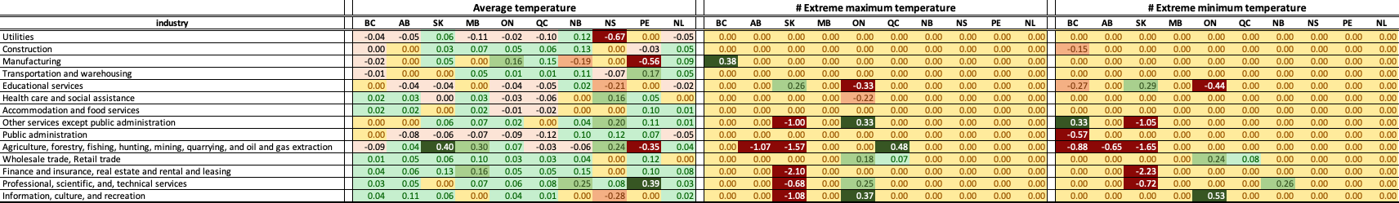
* Monthly average and extreme temperature data were provided by Environment and Climate Change Canada[] and Python package meteostats[].
* Commodity price indices, geographical data, monthly economical productivity data were provided by Statistics Canada[].
* Annual CAD-USD currency rates were provided by Bank of Canada[].

Slide 3



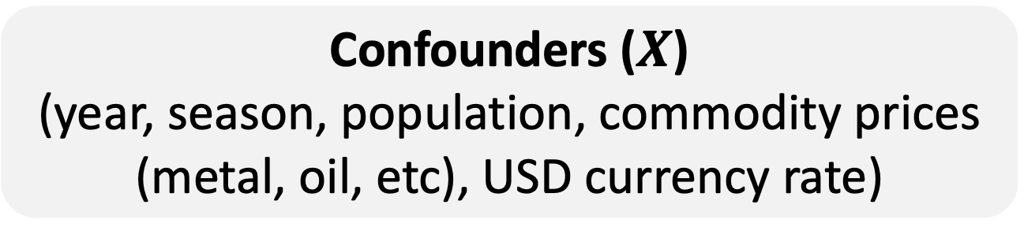




Confounder ($X$)
Confounders ($X$)
(year, season, population, commodity prices (metal, oil, etc), USD currency rate)
Instrument (Z)
(latitude & longitude)
Measured & unmeasured confounder ($X$)
Stage 1: $T=α∗Z+ε_{T}$
Instrument (Z)
(latitude & longitude)
Treatment (T)
(temperature)
Outcome (Y)
(production)
Treatment (T)
(temperature)
Outcome (Y)
(production)
Stage 1: $T \sim Z$
Stage 2: $Y\sim 𝔼\left(T \right| Z)+X$
Stage 2: $Y=β_{ATE}∗𝔼\left(T \right| Z)+θX+εY$
Unmeasured confounder ($U$)

